Slide 1
Insurance pricing game
Solution by WorldExperts
David Ling - davidlkl
William Lo - kkwilllo
Gloria Lo - GLo

Slide 2
Background
Bachelor in Actuarial Science @ HKU
Master in Big Data Technology @ HKUST
Data Analyst in GIC (The sovereign wealth fund in Singapore)
Some life insurance experience through internship
Got to know this game through Singapore Actuary Society

Slide 3
Approach
Overall architecture
Models
Pricing

Slide 4
Overall Architecture
Heavy loading
Large
Large Claim Detection Model
Not Large
Normal loading
Price
Policy
Claim estimation model
Expected claim

Slide 5
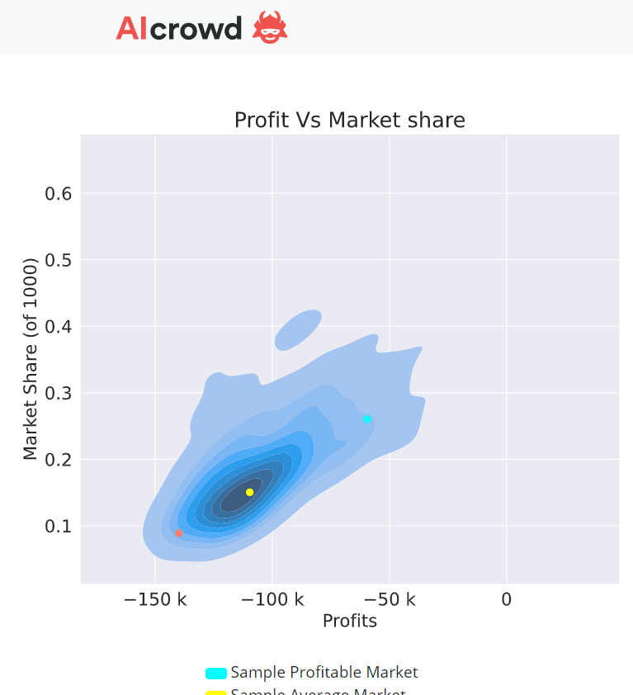
Why this architecture?
Feedback from week 8:
Positive slope
Making more profit for each policy won
The model is fine
Shifted to the left (-ve)
Always winning some large claims
Key to secure higher position
Avg Profit: -30699.19
Rank: 80

Slide 6
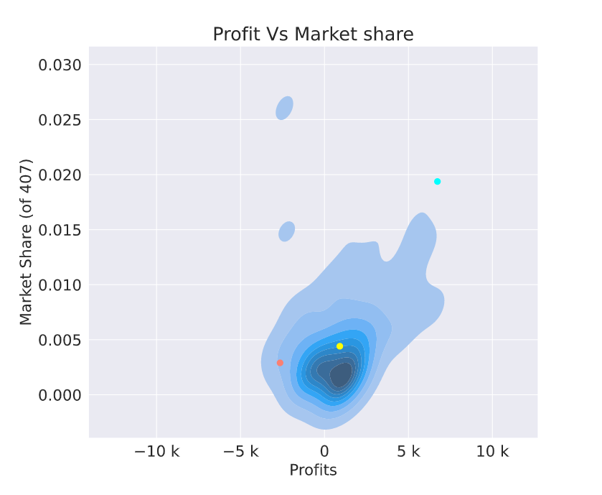
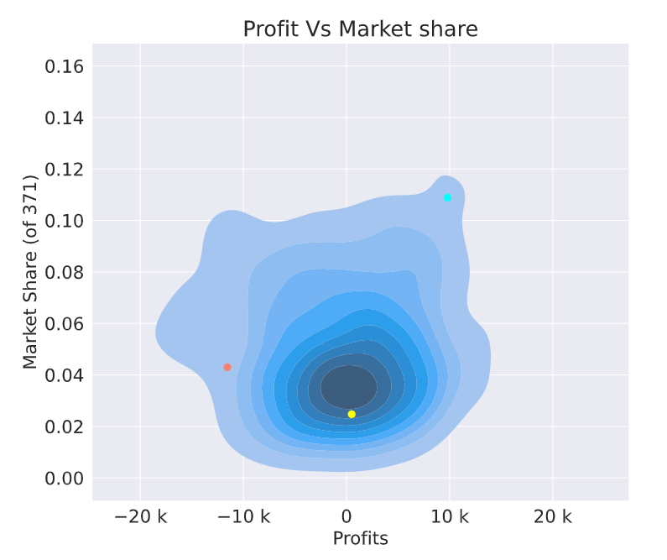
After switching the architecture
Week 9
Avg Profit:787.11
Rank: 21
Week 10
Avg Profit: -571.28
Rank: 45
More stable profit at the cost of some profitability (Also due to some change in pricing strategy)

Slide 7
Large Claim Detection Model
Label: Claim amount >= 3000?
Frequency: 1510 out of 228216 (0.66%)
Python package: Imbalanced-learn
Conservative two-model approach:
XGBClassifier
with bagging and resampling
Predicted as “Large” by any of them
Large claim
Policy
Logistic Regression
with re-weighting
Not Large claim
Threshold: 0.5

Slide 8
Large Claim Detection Model
 | Predict: Not Large | Predict: Large | Total Count
Actual: Not Large | 122801 | 103905 | 226706
Actual: Large | 249 | 1261 | 1510
Total count | 123050 (54%) | 105166 (46%) | 228216 (100%)
Large claim % | 0.20% | 1.20% | 0.66%
Large claim % drops to 0.2% from 0.66%
Sacrifice ~46% of the market shares

Slide 9
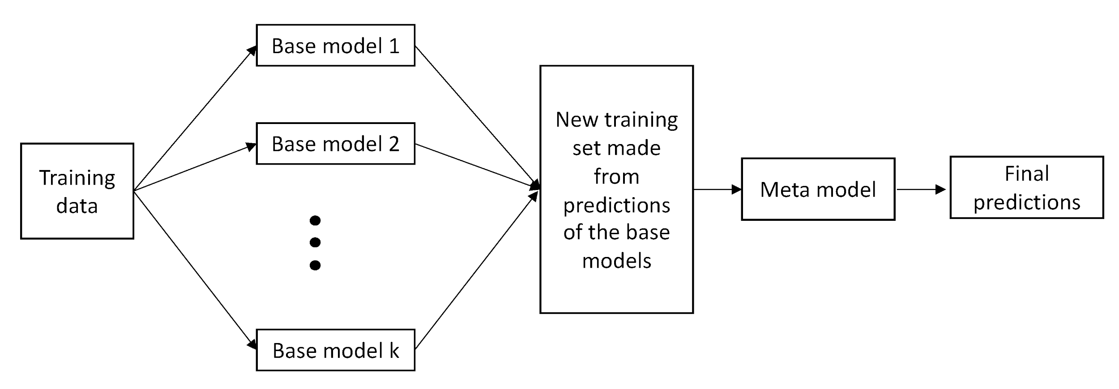
Claim Estimation Model
Trained by all data (i.e. does not exclude the zeros)
Claim amount is capped by 5k
Error metrics: Tweedie Loss, RMSE (Not robust to outlier)
Stacking:
“Not so bad” and independent
Simple (e.g. Linear model / Simple averaging)

Slide 10
Claim Estimation Model - Base models
GLM x 1
Tweedie Regression
More handcrafted features (Interactions, binnarizations ...)
Gradient Boosting Machine x 4
XGBoost, LightGBM, Catboost, Deep Forest
Monotonicity Constraint
Neural Networks x 2
Shallow and small (2 - 3 dense layers, 64 - 128 neurons)
Objective functions:
Tweedie Loss - Predict μ
Zero-inflated Log-normal distribution likelihood - Predict p, μ|p and σ|p

Slide 11
Claim Estimation Model - Meta model
Dataset:
Prediction from base models as Features
GLM_pred | GBM1_pred | GBM2_pred | GBM3_pred | GBM4_pred | NN1_pred | NN2_pred | Actual Claim
100 | 85 | 90 | 95 | 90 | 110 | 105 | 100
Model:
GLM (Tweedie Regression)
Robust and avoid overfitting

Slide 12
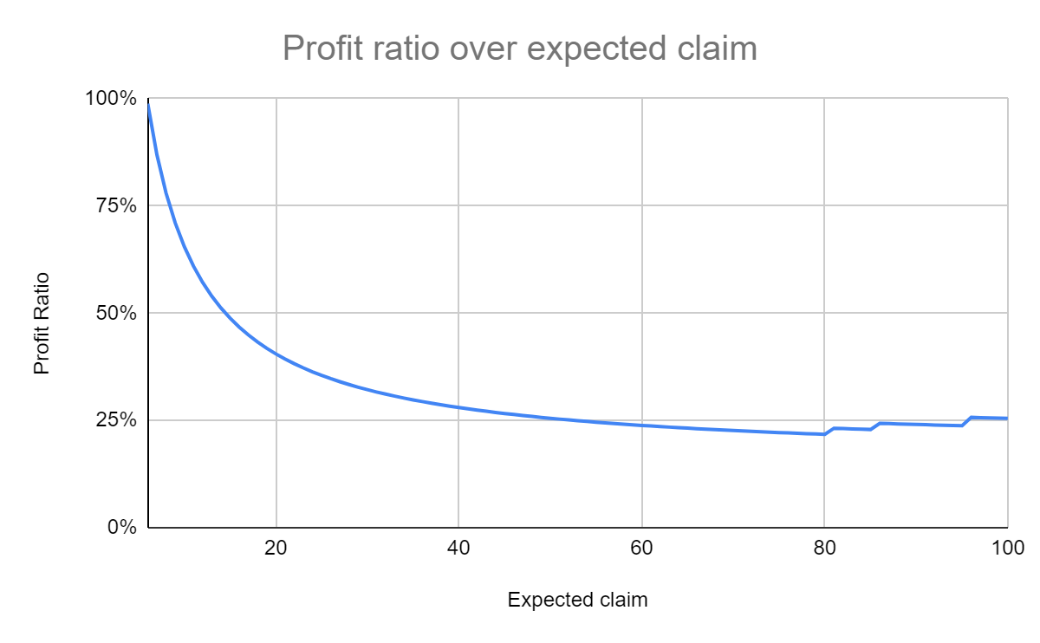
Pricing
Price = Max(5, (1 + Profit loading) * Expected claim) + Fixed loading
Profit loading = 15.5% + conditional loading
Based on large claim detection model
Predicted as Large Claim | 50%
Based on percentile in expected claim
Top 5% | 5%
Top 5-15% | 3%
Top 15-20% | 1.5%
Fixed loading = 5

Slide 13

Thanks!
Contact:
lingkaileong@gmail.com
davidlkl@github

